Slide 1
Energy and the Economy
Bumping against the Growth Ceiling
Gail Tverberg, August 13, 2011

Slide 2
We have all been taught that economic growth can continue forever
What if economic growth really can’t continue forever?
What if we really are growth hitting limits now?
Where do we go from here, if we are hitting limits now?

Slide 3
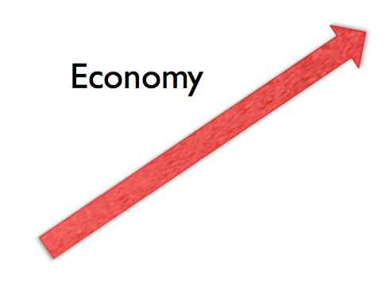

Brief statement of problem:
We have an economy that needs growth
We have limited oil supply that constricts growth

Slide 4
Our Economy Needs Growth

Slide 5
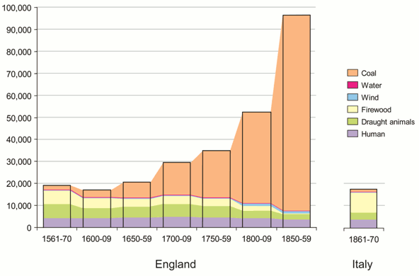
World has used fossil fuels for 450 years
Helped create economic growth
Helped create belief that economic growth will always continue

Slide 6
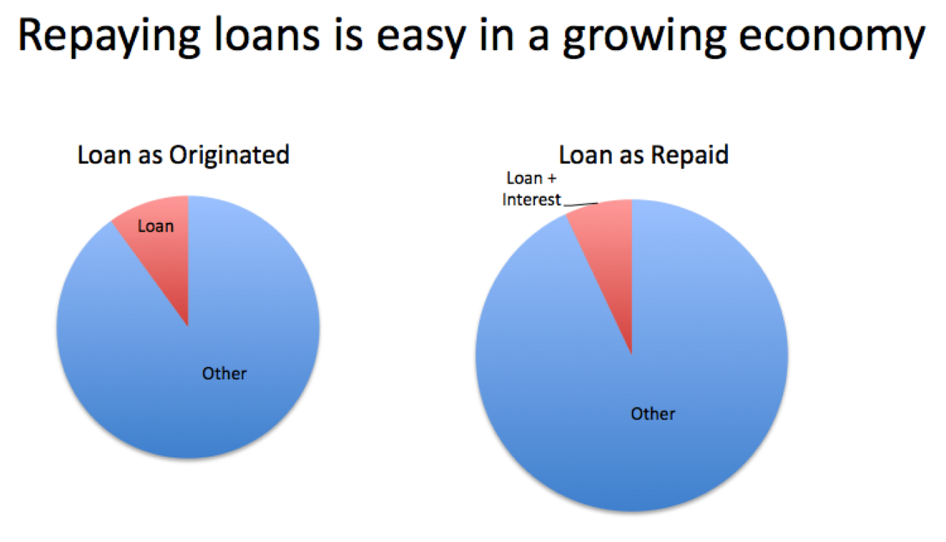
Our financial system depends on growth

Slide 7
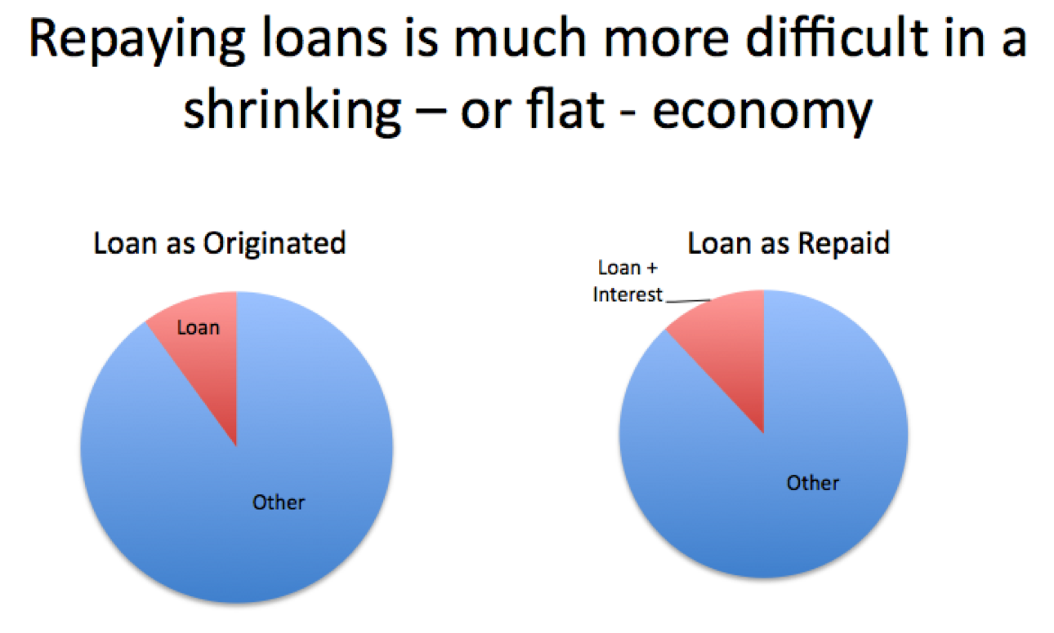

Slide 8
Reinhart and Rogoff looked at 800 years of repayment of sovereign debt
They report --
“It is notable that the non-defaulters, by and large, are all hugely successful growth stories.”
Countries that were growing could repay debt!

Slide 9




Growth provides many benefits
Rising home prices
Rising stock prices
Rising employment
Rising taxes;
Rising church contributions

Slide 10
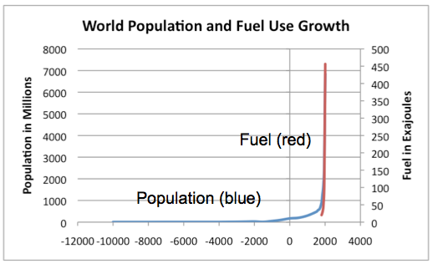
Use of fossil fuels allowed population to expand greatly
Note: Population from US Census Bureau website; fuel use from
Energy Transitions: History, Requirements, Prospects,
Appendix A by Vaclav Smil; Praeger, 2010.

Slide 11


A few of oil’s many uses
Fertilizer
Pesticides
Herbicides
Diesel for tractors
Fast transport to market
Diesel for irrigation
Fuel for refrigeration
Asphalt for roads
Medicines
Plastics
Gasoline
Synthetic cloth
Building materials
Easier metal extraction and working
Diesel for earth movers

Slide 12
Economic decline leads to many bad outcomes
Many debt defaults
Declining home prices
Fewer people employed
Declining tax revenue; rising unemployment claims
Declining stock market
Declining church contributions

Slide 13
Limited oil supply is constricting economic growth

Slide 14
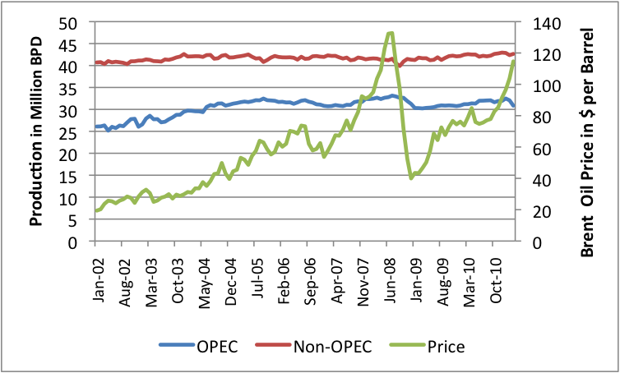
Oil production is no longer responsive to rising price
World oil production has been pretty much level since 2005!
Note: “Crude and Condensate” oil amounts. Based on EIA data.

Slide 15
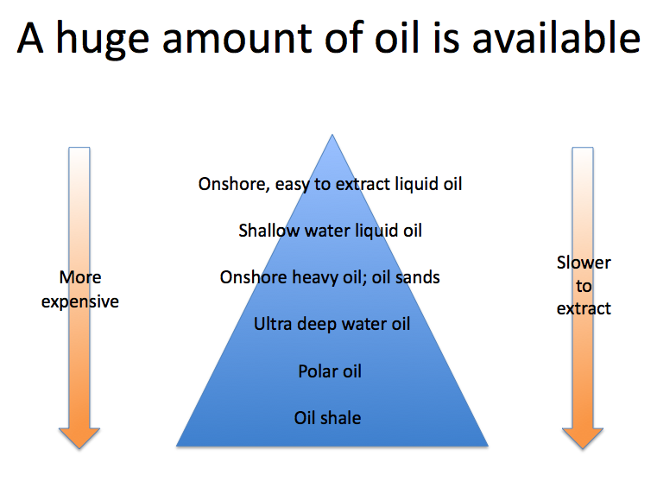
How can this happen?

Slide 16
But in practice there are huge obstacles
Cheap oil is mostly gone
Expensive oil seems to cause recession
  James Hamilton: 10 out of 11 most recent recessions followed oil price spikes
Major investment needs to be made, well in advance of when oil is needed
Prices haven’t been high enough, long enough, to support huge investment needed

Slide 17
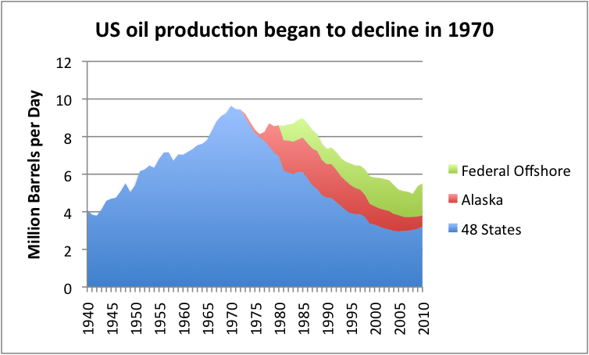
Leveling of world oil supply is not entirely unexpected
Oil production in many countries has started to decline

Slide 18
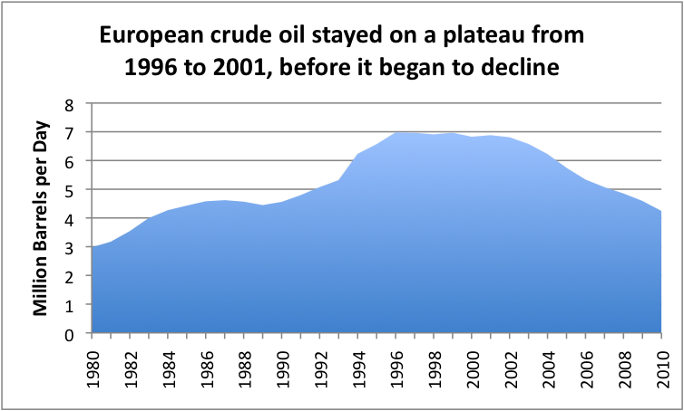
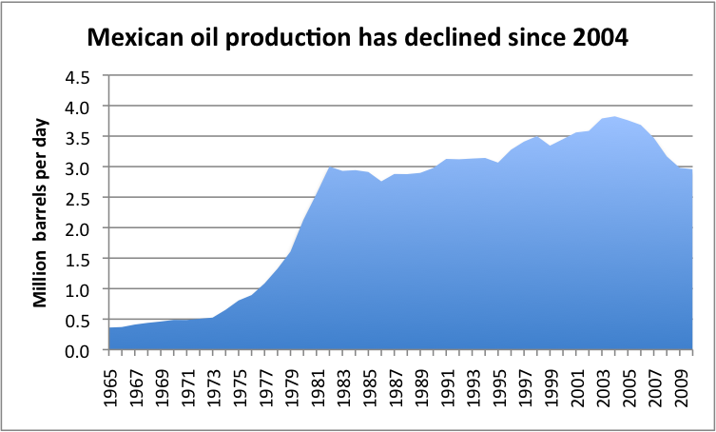

Slide 19
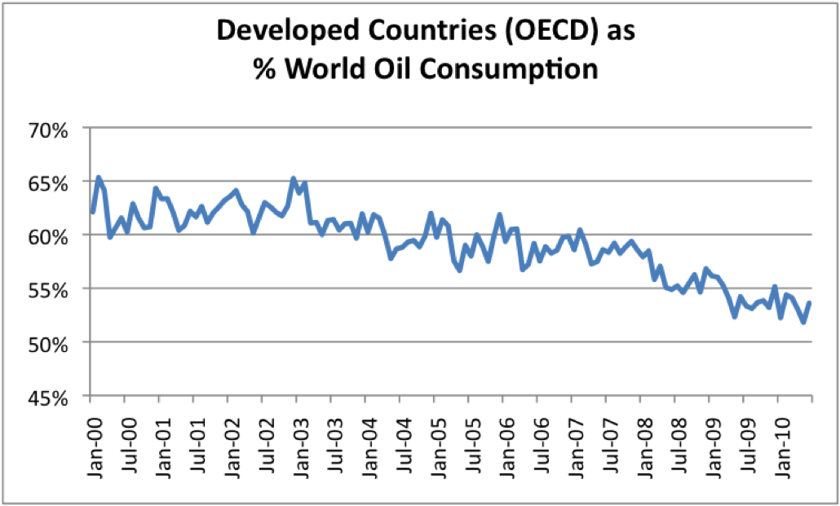
Part of our problem is that China, India, etc. are consuming more of the oil

Slide 20
An economy without enough oil stops growing

Slide 21
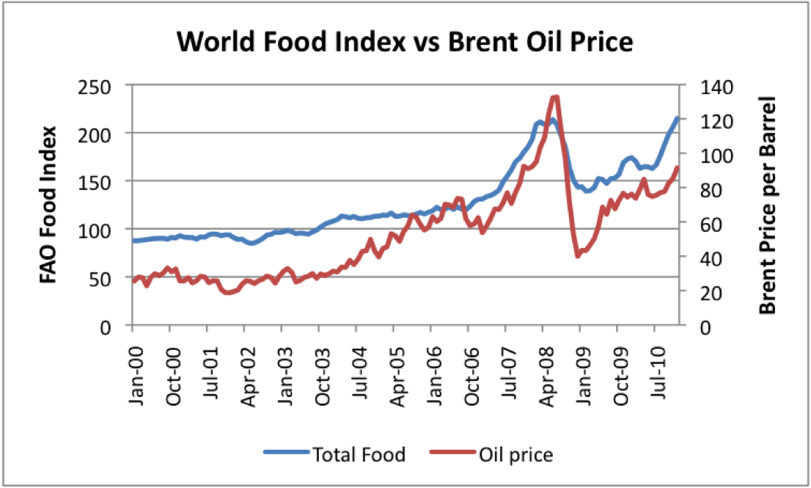
Food prices tend to rise with oil prices

Slide 22
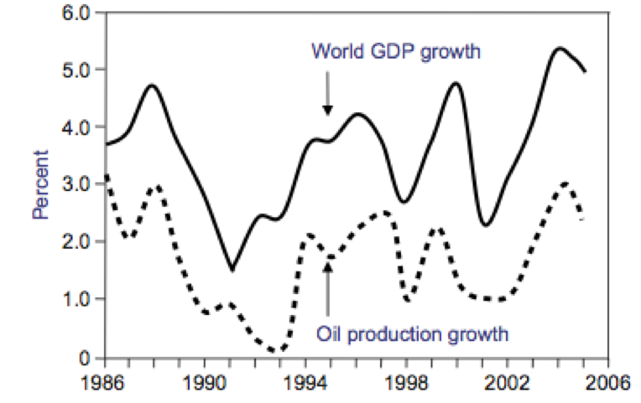
History shows a close tie between world economic growth and oil growth
Source: Robert L Hirsch. Mitigation of maximum world oil production:
Shortage scenarios. Energy Policy 2008

Slide 23
If oil shortage
Food and oil prices rise
People’s incomes don’t rise
People cut back on discretionary goods
Debt defaults rise
Result: Recession

Slide 24
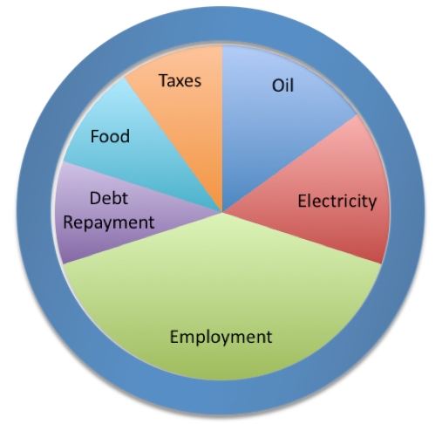
Shrinkage of economy is like making a smaller recipe batch

Slide 25
What happens after an economy hits the ceiling?

Slide 26
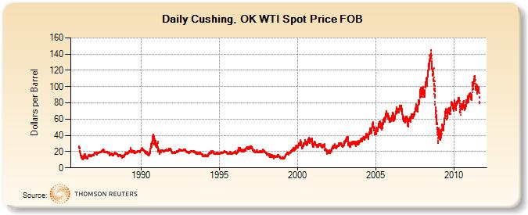
For one thing, oil prices keep spiking up
Recession hits and continues on the down slope
Looks like we are heading into a recession again

Slide 27
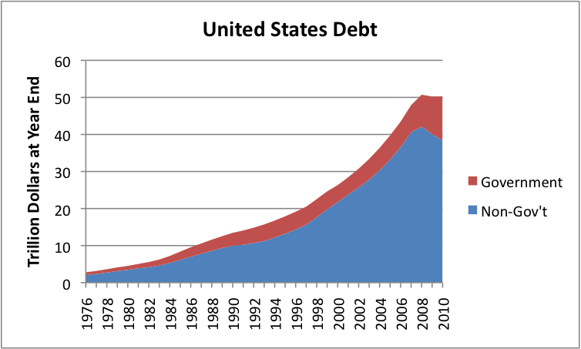
For another, non-government debt starts to decline, and governmental debt soars!

Slide 28
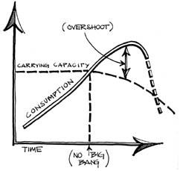
We don’t know for sure how this all ends
Some views are that this will end badly
Not too different from throwing a ball up and hitting the ceiling

Slide 29
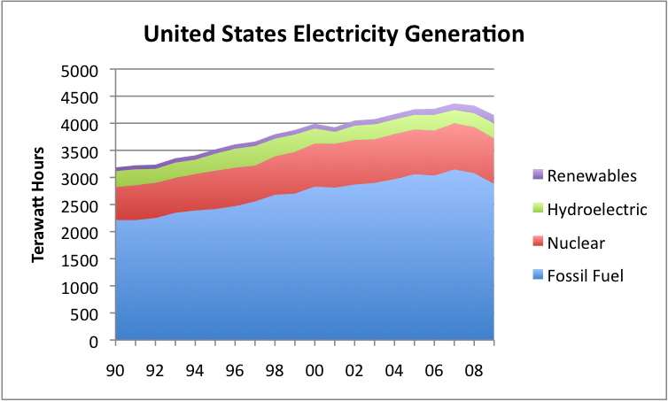
Alternate energy sources are too little, too late
Biofuels amounted to 4.4% of US petroleum consumption in 2009
Most mitigations are electric
  Don’t directly help oil problem – also small in total

Slide 30
Where do we go from here?

Slide 31
Take one day at a time
What to expect
  Another recession, probably severe
  More layoffs
  Huge governmental problems
  Possible cutback in government programs
    More hungry people
    Possibly even nearby riots
  Most every congregation will have similar circumstances
    Many will need to choose between debt repayment and staff
    Long-term health of banks/insurance companies holding debt is doubtful

Slide 32
A few thoughts
Do what we can today
  Count our blessings!
No real solutions
  Keep some water and food on hand
  Don’t count on always having electricity
  Gardening makes people feel like they are doing something
Don’t count on paper investments
High population is an issue – smaller families?
Need help finding the right way

